Slide 1
Black Magic
Brad Bensch, Chad Koppes, Kevin Mulligan, Bill Spaw, Jenny Zhen

Slide 2
Agenda
R1 Overview
R2 Preparation
Design Changes
Memento
Non-Features
Questions

Slide 3
R1 Overview
Cleaned up most dangling issues
General bug fixing
General code refactoring
Added most undone R1 functionality

Slide 4
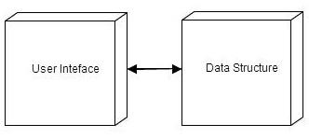
R2 Preparation
Good transition from release 1 to release 2
Took a more meta-perspective on the overall design:

Slide 5
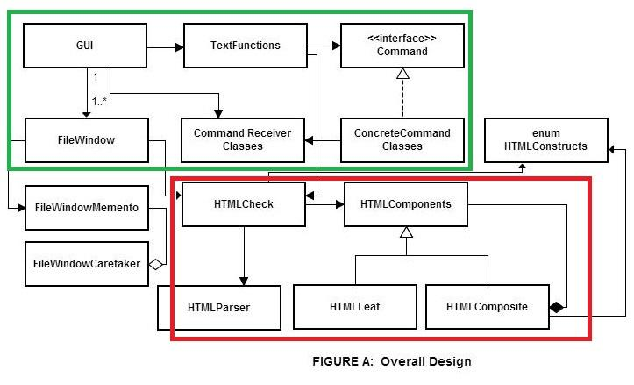
Design Changes

Slide 6
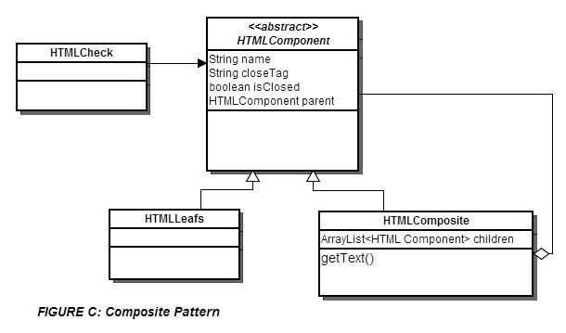
Design Changes:
Composite

Slide 7
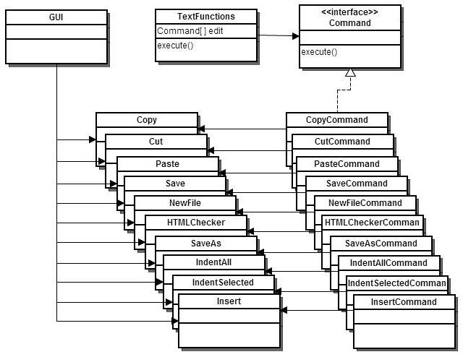
Design Changes: Command

Slide 8
Memento
Added for undo functionality, FileWindow as Originator
Able to save any state of each FileWindow
Good compatibility with the Command Structure

Slide 9
Non-Features
Outline Mode
HTML tree
Hiding levels of HTML and text
Problems:
HTML tags on the same level
User interaction when using feature
Auto-Indent
Indenting all/selected works

Slide 10
Questions?

